Slide 1







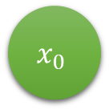

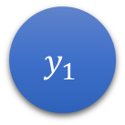







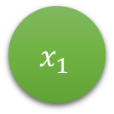


Input Layer
Hidden Layer 1
Hidden Layer 2
Output Layer
$$x_{0}$$
$$w_{1}$$
$$h_{0}$$
$$w_{5}$$
$$h_{3}$$
$$w_{9}$$
$$y_{0}$$
$$w_{2}$$
$$w_{6}$$
$$w_{10}$$
$$w_{3}$$
$$w_{7}$$
$$w_{11}$$
$$x_{1}$$
$$h_{1}$$
$$h_{4}$$
$$y_{1}$$
$$w_{4}$$
$$w_{8}$$
$$w_{12}$$

Slide 2
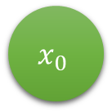





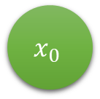

$$x_{0}$$
Activation function e.g.) Sigmoid, ReLU, tanh
$$w_{0}$$
$$x_{0}$$
$$w_{1}$$
$$z=b+\sum_{i=1}^{n}{x_{i}∙w_{i}}$$
$$activation(z)$$
output
$$w_{n}$$
$$x_{n}$$
Weighted sum of the inputs plus the bias “b”.

Slide 3




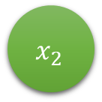
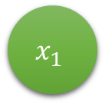

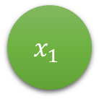






$$x_{1}$$
$$w_{1}$$
$$x_{2}$$
$$w_{2}$$
$$z=\sum_{i=1}^{n}{x_{i}∙w_{i}}$$
$$activation(z)$$
$$y$$
$$w_{n}$$
$$x_{n}$$
$$x_{1}$$
$$w_{1}$$
$$z=\sum_{i=1}^{n}{x_{i}∙w_{i}}$$
$$sgn(z)$$
$$y$$
$$w_{2}$$
$$x_{2}$$

Slide 4

$$f(x)$$

Slide 5
Artificial Intelligence
Any technique that enable computers to mimic human behavior
Machine Learning
A subset of artificial intelligence field in computer science that uses statistical techniques to give the computer the ability to learn
Deep Learning
A subset of machine learning in which artificial neural networks adapt and learn from large amounts of data

Slide 6













$$C(w_{1},b_{1},w_{2},b_{2},w_{3},b_{3})$$
$$b_{1}$$
$$b_{2}$$
$$b_{3}$$
$$w_{1}$$
$$w_{2}$$
$$w_{3}$$
$$Cost= C_{0}\left(…\right)=(a^{\left(L\right)}−y)^{2}$$
$$a(L$$
For example: $(0.66−1)^{2}$
Target Output
0.48
0.66
1.00
$$a^{L−1}$$
$$a^{L}$$
$$y$$

Slide 7

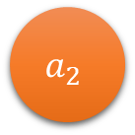





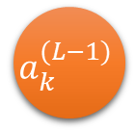
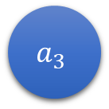


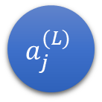

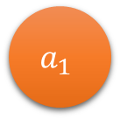


$$a_{0}$$
$$w_{1}$$
$$a_{1}$$
$$w_{2}$$
$$a_{2}$$
$$w_{3}$$
$$a_{3}$$
$$\hat{y}$$
$$a_{2}$$
$$w_{3}$$
$$a_{3}$$
$$a^{(L −1)}$$
$$a^{(L)}$$
$$a_{k}^{(L−1)}$$
$$w_{jk}^{(L)}$$
$$a_{j}^{(L)}$$

Slide 8















$$w^{(L)}$$
$$a^{(L−1)}$$
$$b^{(L)}$$
$$w^{(L)}$$
$$a^{(L−1)}$$
$$b^{(L)}$$
$$z^{(L)}$$
$$z^{(L)}$$
$$y$$
$$a^{(L)}$$
$$y$$
$$a^{(L)}$$
$$C_{0}$$
$$C_{0}$$

Slide 9
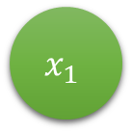






$$x_{1}$$
neuron
inputs
output
$$x_{2}$$
$$x_{1}$$
$$w_{1}$$
activation
function
$$y$$
$$w_{2}$$
$$x_{2}$$

Slide 10













$$x_{0}$$
$$w_{0}$$
neuron
$$x_{1}$$
$$w_{1}$$
inputs
$$y$$
output
$$w_{n}$$
$$x_{2}$$
$$x_{0}$$
$$w_{0}$$
neuron
$$x_{1}$$
$$w_{1}$$
inputs
$$y$$
output
$$w_{n}$$
1
bias

Slide 11









$$x_{1}$$
Training Data:
Point(13, 6)
Label: -1
Learning Rate: 0.01
$$w_{1}$$
13
Step 1
-0.254
Step 4
1.165536>0
$$y$$
$$w_{2}$$
$$1$$
0.432
Error: -1 – 1= -2
$$x_{2}$$
6
13
-0.254
13
$$w_{1}=0.06604=−0.254∗(−2∗13∗0.01)$$
Step 2
Step 5
$$y$$
$$y$$
0.432
6
6
$$w_{2}=−0.05184=0.432∗(−2∗6∗0.01)$$
13
-0.254
Step 3
1.165536>0
$$1$$
0.432
6

Slide 12



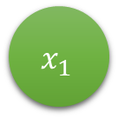














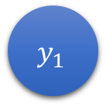


$$w_{jk}$$
$$x_{0}$$
$$w_{1}$$
$$h_{0}$$
$$w_{5}$$
$$h_{3}$$
$$w_{9}$$
$$y_{0}$$
$$w_{2}$$
$$w_{6}$$
$$w_{10}$$
$$w_{3}$$
$$w_{7}$$
$$w_{11}$$
$$x_{1}$$
$$h_{1}$$
$$h_{4}$$
$$y_{1}$$
$$w_{4}$$
$$w_{8}$$
$$w_{12}$$

Slide 13
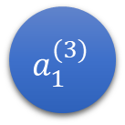



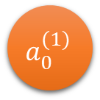
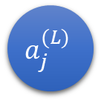

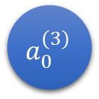




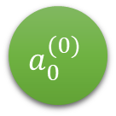


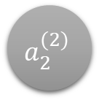
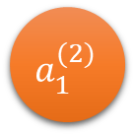

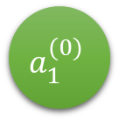

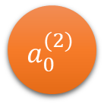









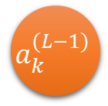



$$a_{k}^{(L−1)}$$
$$w_{j,k}^{(L)}$$
$$a_{j}^{(L)}$$
hidden units
$$a_{0}^{(0)}$$
$$w_{0,0}^{(1)}$$
$$a_{0}^{(1)}$$
$$w_{0,0}^{(2)}$$
$$a_{0}^{(2)}$$
$$w_{0,0}^{(3)}$$
$$a_{0}^{(3)}$$
$${\hat{y}}_{0}$$
$$w_{0,1}^{(1)}$$
$$w_{0,1}^{(2)}$$
$$w_{0,1}^{(3)}$$
input units
output values
$$a_{1}^{(0)}$$
$$w_{1,0}^{(1)}$$
$$a_{1}^{(1)}$$
$$w_{1,0}^{(2)}$$
$$a_{1}^{(2)}$$
$$w_{1,0}^{(3)}$$
$$a_{1}^{(3)}$$
$${\hat{y}}_{1}$$
$$w_{1,1}^{(1)}$$
$$w_{1,1}^{(2)}$$
$$w_{1,1}^{(3)}$$
$$w_{0,2}^{(1)}$$
$$w_{0,2}^{(2)}$$
$$w_{0,2}^{(3)}$$
$$w_{1,2}^{(1)}$$
$$w_{1,2}^{(2)}$$
$$w_{1,2}^{(3)}$$
output units
$$a_{2}^{(0)}$$
$$a_{2}^{(1)}$$
$$a_{2}^{(2)}$$
bias units

Slide 14
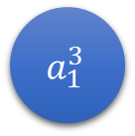



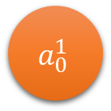

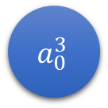







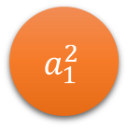


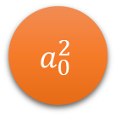






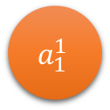
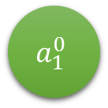




$$a_{0}^{0}$$
$$a_{0}^{1}$$
$$0.28$$
$$a_{0}^{2}$$
$$0.32$$
$$a_{0}^{3}$$
$$0.63$$
$${\hat{y}}_{0}$$
$$0.50$$
$$0.82$$
$$0.70$$
$$a_{1}^{0}$$
$$0.39$$
$$a_{1}^{1}$$
$$0.42$$
$$a_{1}^{2}$$
$$0.83$$
$$a_{1}^{3}$$
$${\hat{y}}_{1}$$
$$0.50$$
$$0.49$$
$$0.72$$
$$0.34$$
$$0.71$$
$$0.27$$
$$0.45$$
$$0.70$$
$$0.59$$
$$+1$$
$$+1$$
$$+1$$

Slide 15
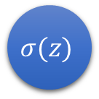

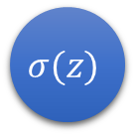



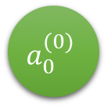


$$a_{0}^{(0)}$$
$$σ(z)$$
$$0.28$$
$$σ(z)$$
$$0.32$$
$$σ(z)$$
$$0.63$$
$${\hat{y}}_{0}$$
$$0.50$$
$$0.82$$
$$0.70$$
$$a_{1}^{(0)}$$
$$0.39$$
$$σ(z)$$
$$0.42$$
$$σ(z)$$
$$0.83$$
$$σ(z)$$
$${\hat{y}}_{1}$$
$$0.50$$
$$0.49$$
$$0.72$$
$$0.34$$
$$0.71$$
$$0.27$$
$$0.45$$
$$0.70$$
$$0.59$$
$$+1$$
$$+1$$
$$+1$$

Slide 16




$$2$$
$$σ(z)$$
$$0.28$$
$$σ(z)$$
$$0.32$$
$$σ(z)$$
$$0.63$$
$$y_{0}$$
$$0.50$$
$$0.82$$
$$0.70$$
$$1$$
$$0.39$$
$$σ(z)$$
$$0.42$$
$$σ(z)$$
$$0.83$$
$$σ(z)$$
$$y_{1}$$
$$0.50$$
$$0.49$$
$$0.72$$
$$0.34$$
$$0.71$$
$$0.27$$
$$0.45$$
$$0.70$$
$$0.59$$
$$+1$$
$$+1$$
$$+1$$

Slide 18
Low Entropy
Medium Entropy
High Entropy
High Knowledge
Medium Knowledge
Low Knowledge

Slide 19
$$1$$
$$1$$
$$1$$
$$1$$
$$0.75$$
$$0.75$$
$$0.75$$
$$0.25$$
$$0.50$$
$$0.50$$
$$0.50$$
$$0.50$$

Slide 20









Games
Games
$$P\left(blue\right)$$
$$P\left(blue\right)$$
$$P\left(orange\right)$$
$$P\left(winning\right)$$
$$1.00$$
$$0.00$$
$$1.00∗1.00∗1.00∗1.00=1.00$$
$$0.75$$
$$0.25$$
$$0.75∗0.75∗0.75∗0.25=0.105$$
$$0.50$$
$$0.50$$
$$0.50∗0.50∗0.50∗0.50=0.062$$

Slide 21
Entropy: 0
Entropy: 0.81125
Entropy: 1
m
n

Slide 22
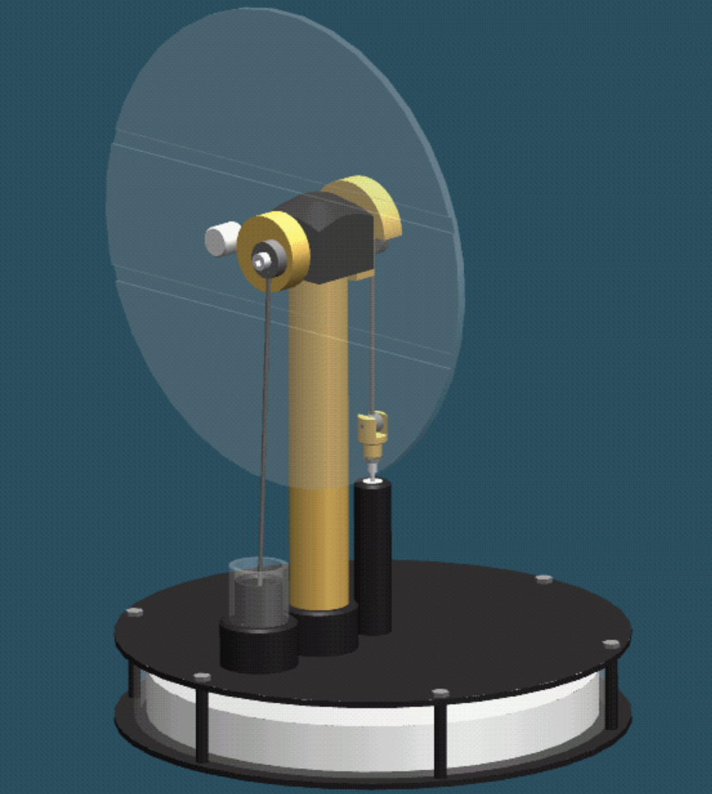
cold plate
piston
hot plate
styrofoam

Slide 23
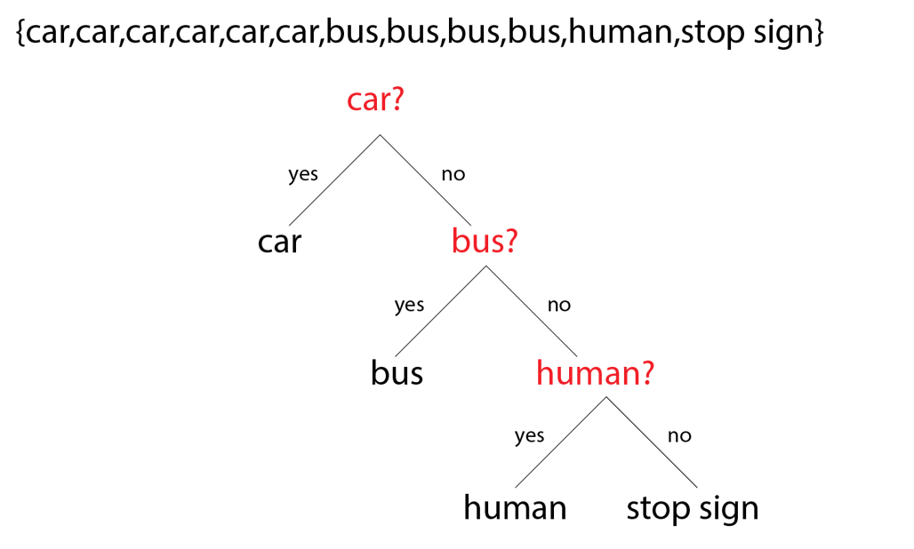

Slide 24
{ dog, dog, dog, dog, dog, dog, dog, dog, dog, dog }
{ dog, dog, dog, cat, cat, cat, rat, rat, bee, bee }
{ dog, dog, dog, dog, cat, cat, cat, rat, rat, bee }
dog?
yes
no
dog
cat?
yes
no
cat
rat?
yes
no
rat
bee

Slide 25
{dog,dog,dog,dog,dog,dog,dog,dog,dog,dog}
{dog,dog,dog,cat,cat,cat,rat,rat,bee,bee}
{dog,dog,cat,cat,cat,cat,rat,rat,rat,bee}
Bucket 1
Bucket 2
Bucket 3

